Slide 1
Database System (CS-103)
Microsoft Access Overview
Mr. Hamza Javed,
Department of Computer Science,
Muslim Youth University, Islamabad, Pakistan

Slide 2
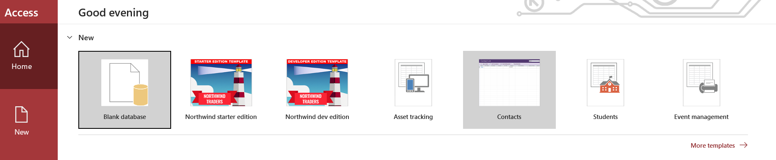
Creating Database in Microsoft Access

Slide 3
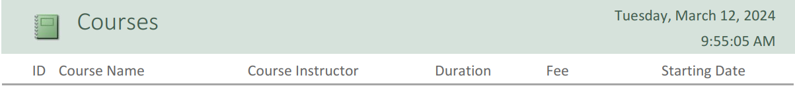
Creating Tables

Slide 4
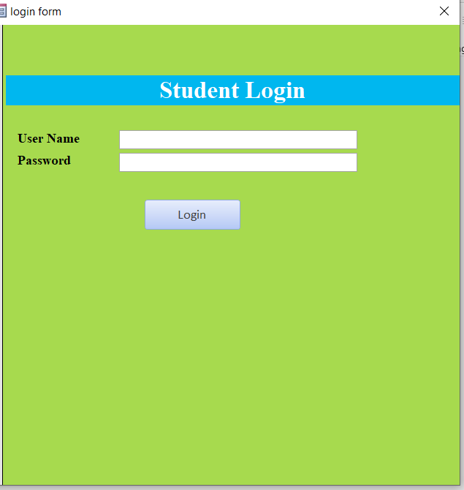
Creating Login Form

Slide 5
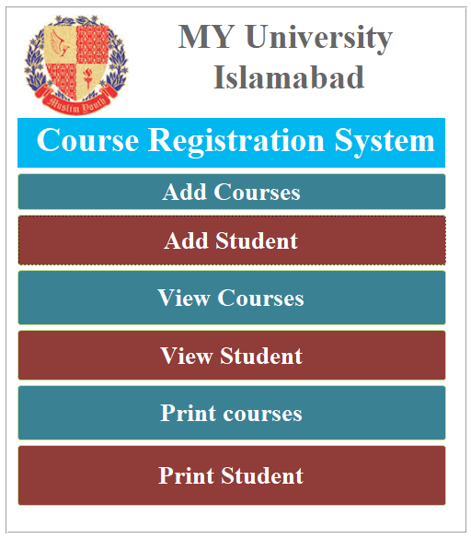
Creating Front end and inserting data

Slide 6
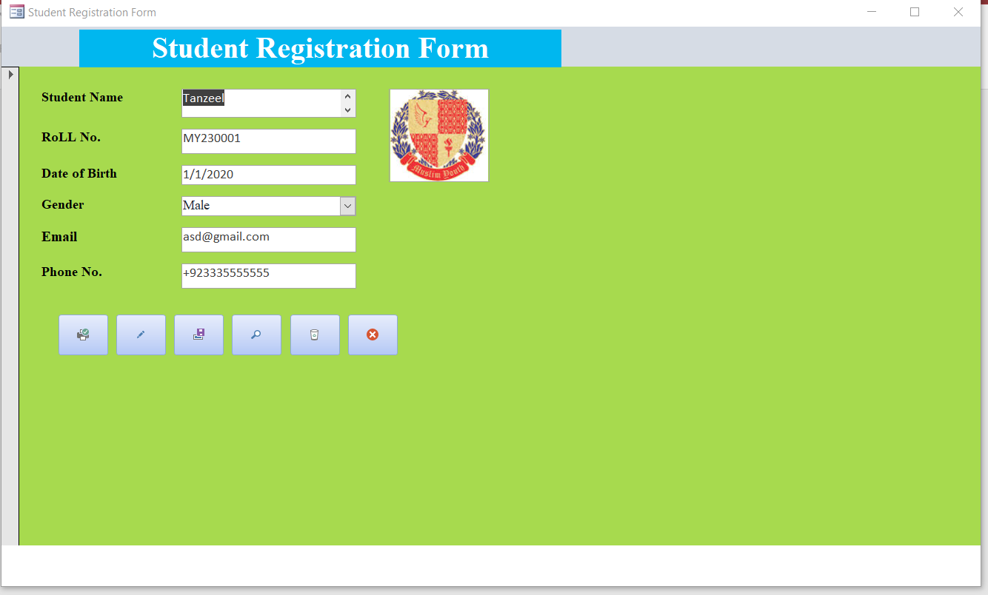
Creating Student Registration Form

Slide 7
Lab Task: Hospital Management System
A Hospital Management System is an integrated information system for managing all aspects of a hospital’s operations such as medical, financial, administrative, legal, and compliance. It includes electronic health records, business intelligence, and revenue cycle management. Hospitals and healthcare facilities improve the quality of healthcare services, reduce operating costs, and improve the revenue cycle by using such hospital management systems.
Your Task are Create Table, Form and Report which contain following information:
Admin login
Patient Detail
Patient Diagnosis
Diagnosis Detail
Doctor Detail
Patient Diet Advice

Slide 8
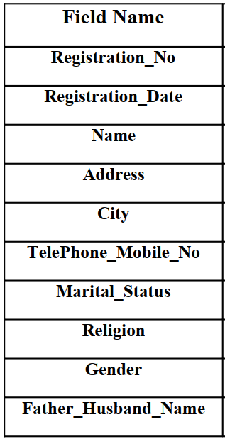
Lab Task: Hospital Management System
Patient Details

